Slide 1
Analyzing Voting Trends United Nations
Amy Mcdonagh
Regis university - Msds 692
March 10, 2018

Slide 2
Overview
Goal #1: Prove that the countries receiving the most foreign aid from the United States nearly always oppose the U.S. diplomatic initiatives voting against the U.S.
Data from Harvard Dataverse
1946 - 2017
Clean, visualize and model historical data
Evaluate “Yes” votes
Compare yes votes of the top 5 countries receiving security aid from the United States
Goal #2: Improve proficiency programming with R

Slide 3
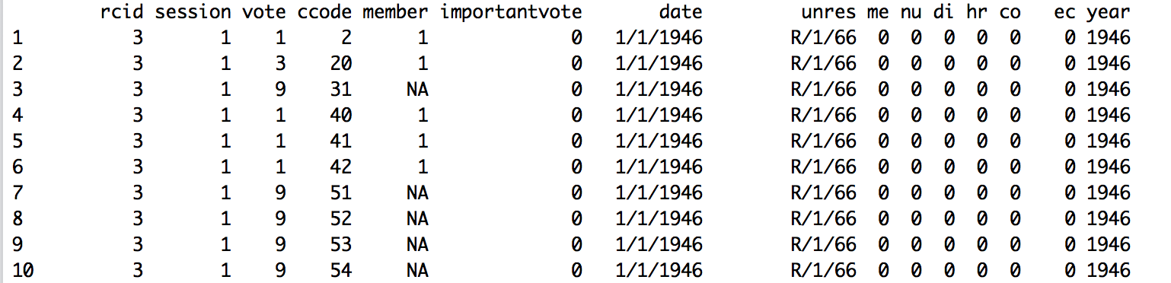
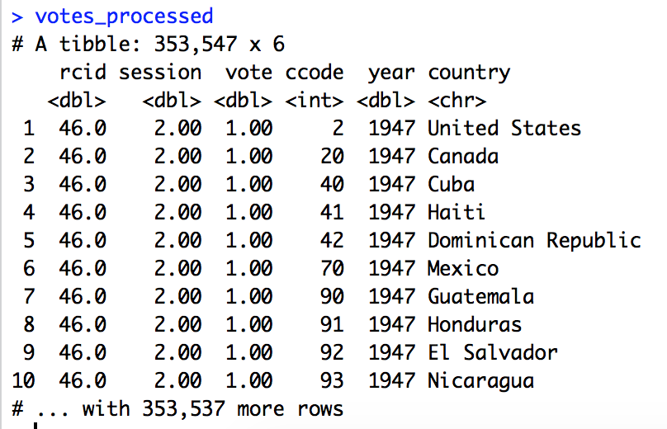
Data
Original Data
Processed data
1 = Yes Vote 2 = Abstain 3 = No Vote
rcid = roll call ID session = which session vote was cast
vote = country’s choice
ccode = country code
Notes:
Original data to votes_processed:
Filter to keep only the columns you want to analyze
Remove everything except for yes, no, abstain
Mutate – clean up raw data to create a processed set of votes
Summarize – take many rows to convert them into one while calculating an overall metric like average or total (percent_yes = mean(vote == 1))
Group_by – when done before summarize you can create 1 row for each sub group instead of one overall group

Slide 4
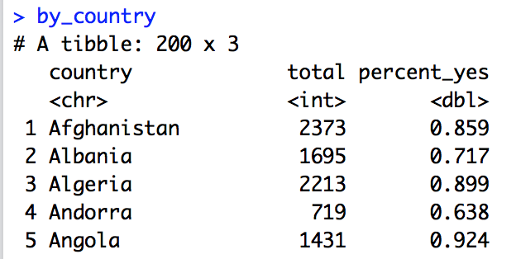
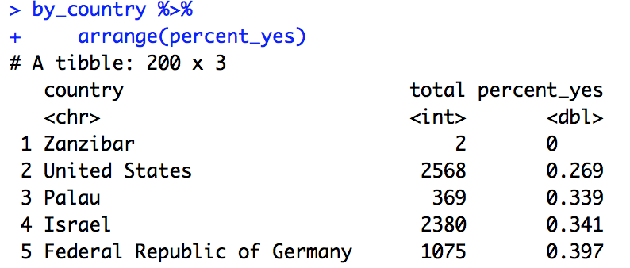
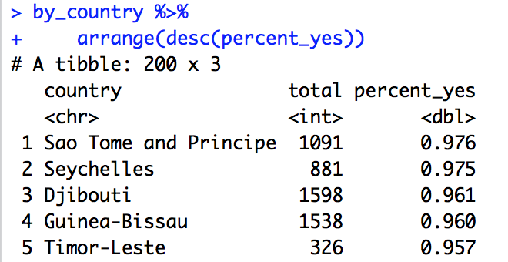
Sorting and Filtering Data
By sorting and filtering you can easily see which country voted yes more often. It is also possible to rule out countries with low voting instances

Slide 5
Quantifying Trends
Linear regression

Slide 6
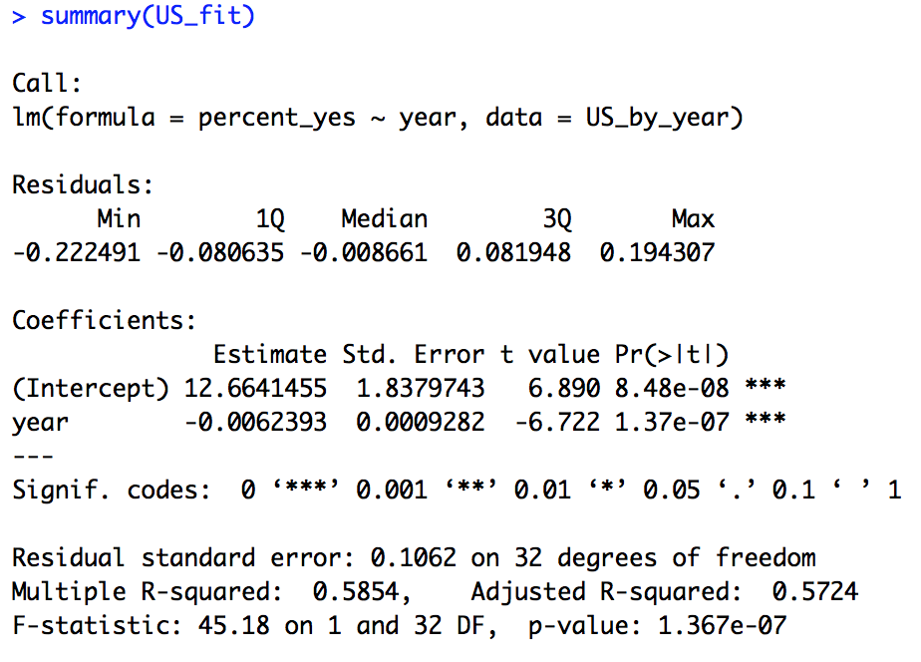
Finding the slope and p-value
Slope
P-value
Notes:
Slope – estimated change each year of the probability of the US voting “yes” = -0.006
P-value – allows you to assess whether a trend could be due to chance, p-values below .05 are significant

Slide 7
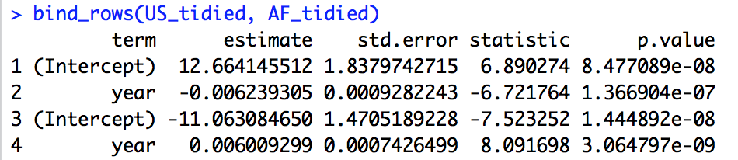
Models are difficult to combine in R
broom package – turns a linear model into a data frame of coefficients
Allows you to extract data
Tidy models can be combined
Build a model for each country and combine them all

Slide 8
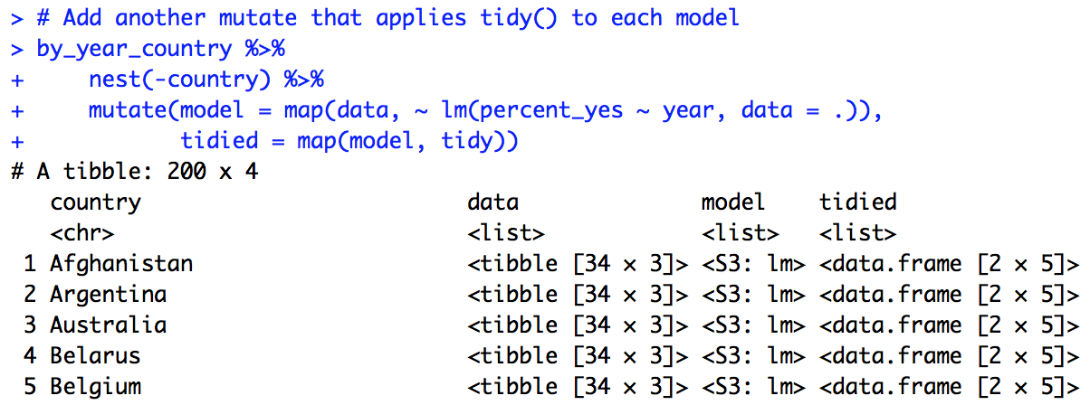
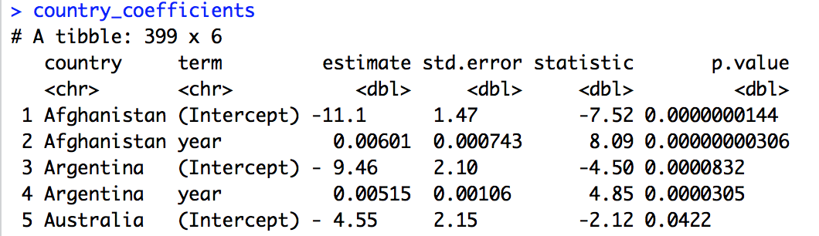
Fitting Multiple Models
Notes:
Allow to asses the level of agreement with the rest of the UN is increasing or decreasing most dramatically
Split in many different data sets – one for each country
Purrr package – use map function that allows you to apply an operation to each item in a list (first a model to the dataset)
Use mutate to define new column “model” and map to apply a linear regression to each item of the data
Tibble – dplyr’s version of a dataframe
___________
Cant combine, visualize or manipulate fit models
Return to broom package to turn each model into tidy data frame of coefficients
Now three columns of data for each country: data = original data, model = linear model and tidied = tidied model
Tidy versions of statistical models are easy to combine (use unnest to bring them all into the top level)
Table of coefficients – all of the details of each model are in one place
FOUR STEPS: 1. nest by country 2. map to fit a model to each dataset 3. map to tidy each model 4. unnest to a table of coefficients

Slide 9
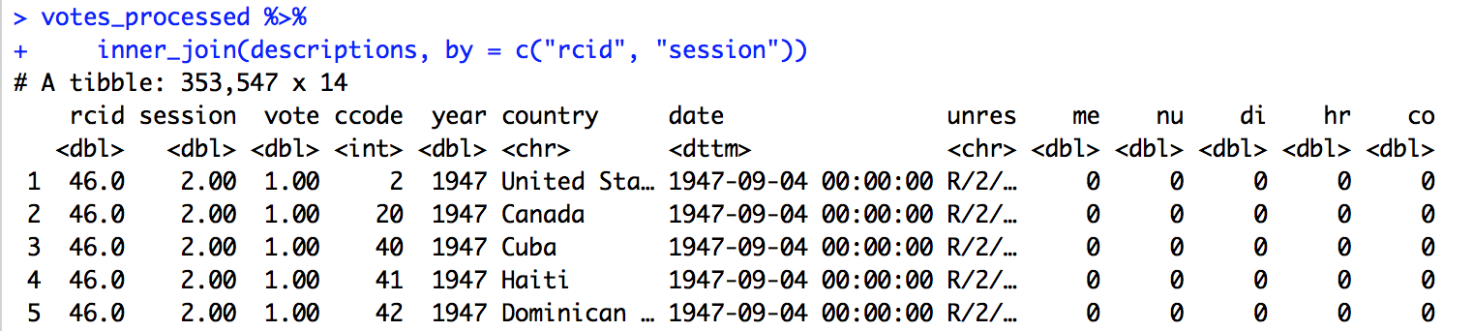
Join Datasets
Descriptions dataset
UN Resolution – what resolution the vote was applied to
Topic Information – whether each vote pertained to one of six topics
Combine with votes_processed dataset

Slide 10
ANALYSIS
Top countries receiving security assistance aid from the United States:
Afghanistan - $3.67B
Israel - $3.1B
Egypt - $1.31B
Iraq - $808M
Jordan - $367.6M
The argument: Countries receiving security assistance aid from the U.S. routinely oppose the diplomatic initiatives and vote against the U.S.

Slide 11
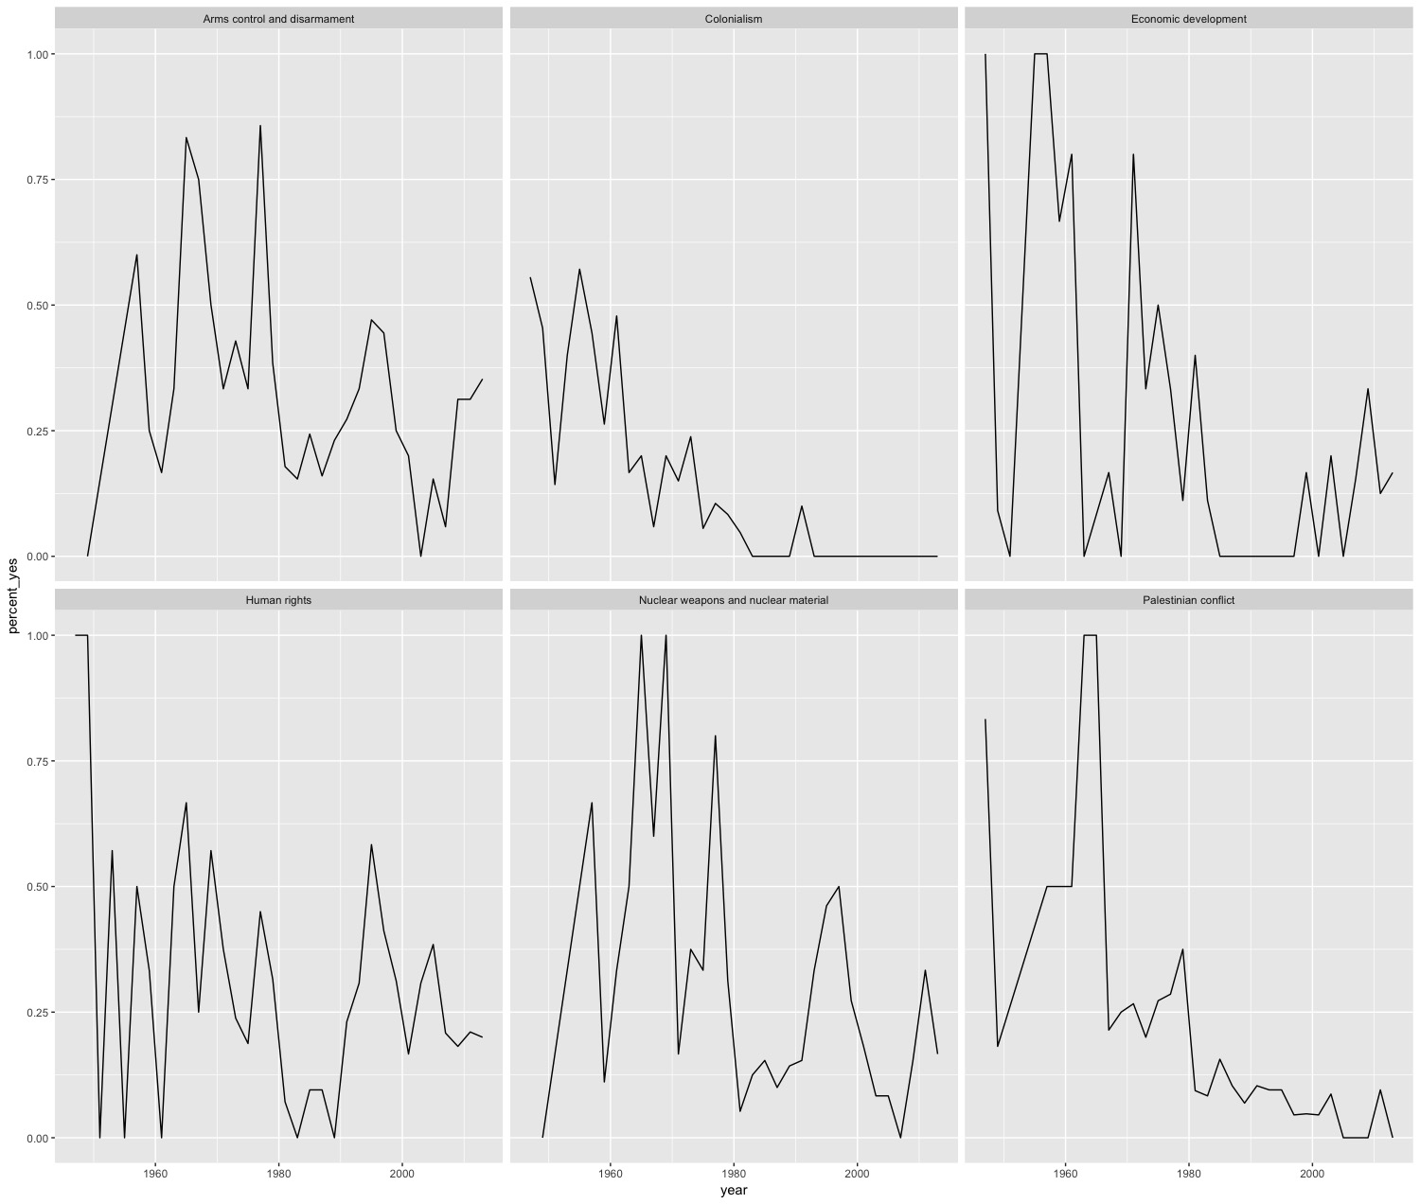
UNITED STATES BY TOPIC OVER TIME
Topics:
Palestinian conflict
Nuclear weapons and nuclear material
Arms control and disarmament
Human rights
Colonialism
Economic Development

Slide 12
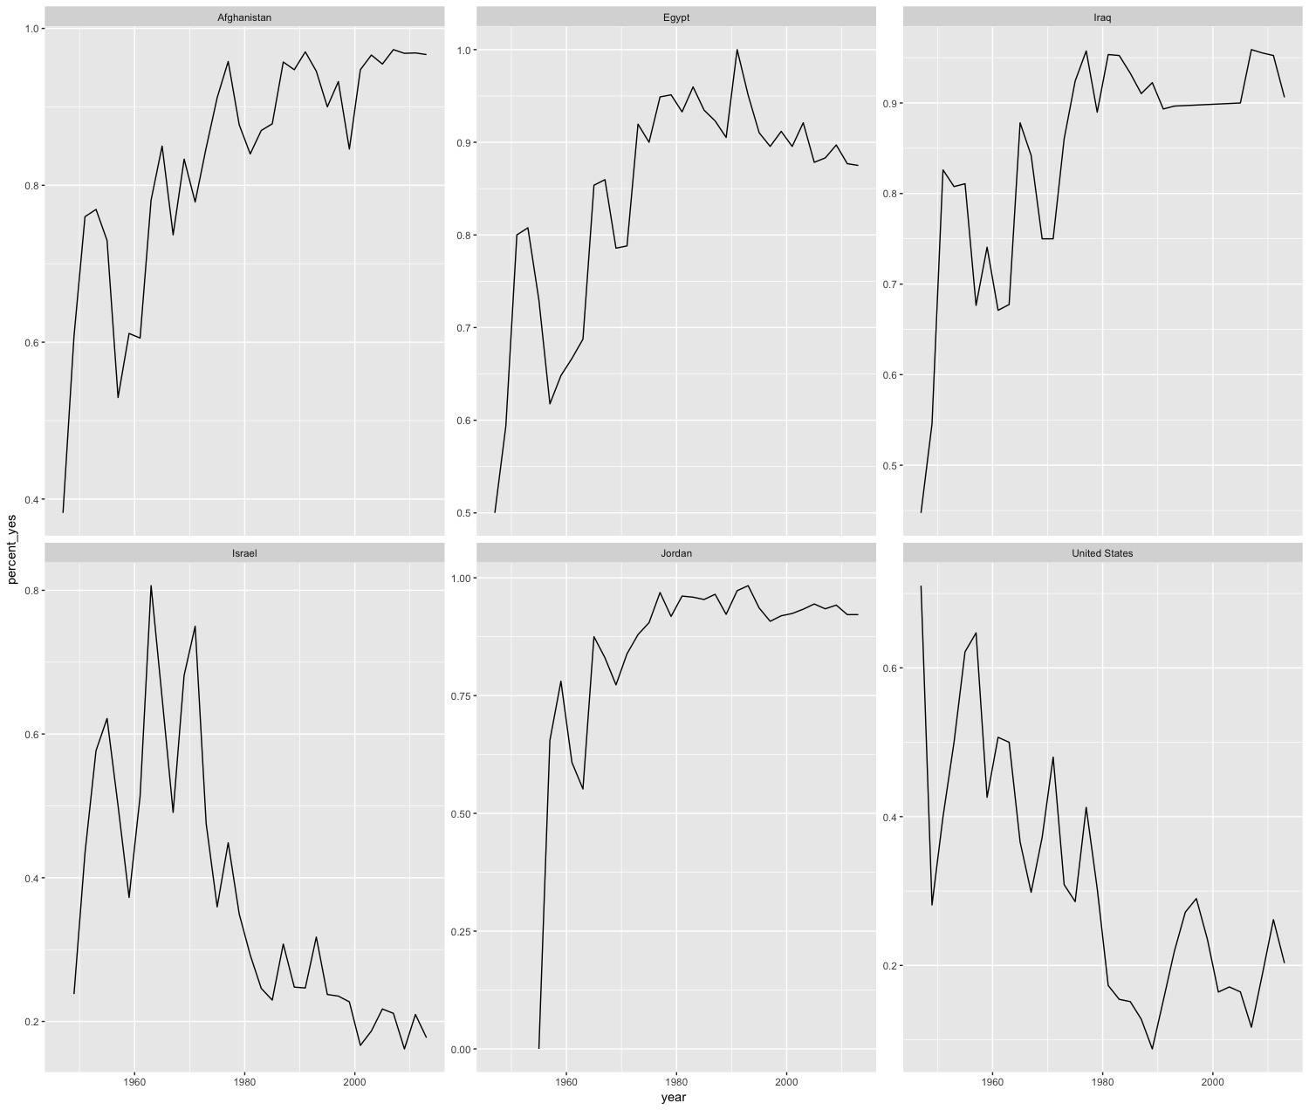
BY COUNTRY YES VOTE OVER TIME

Slide 13
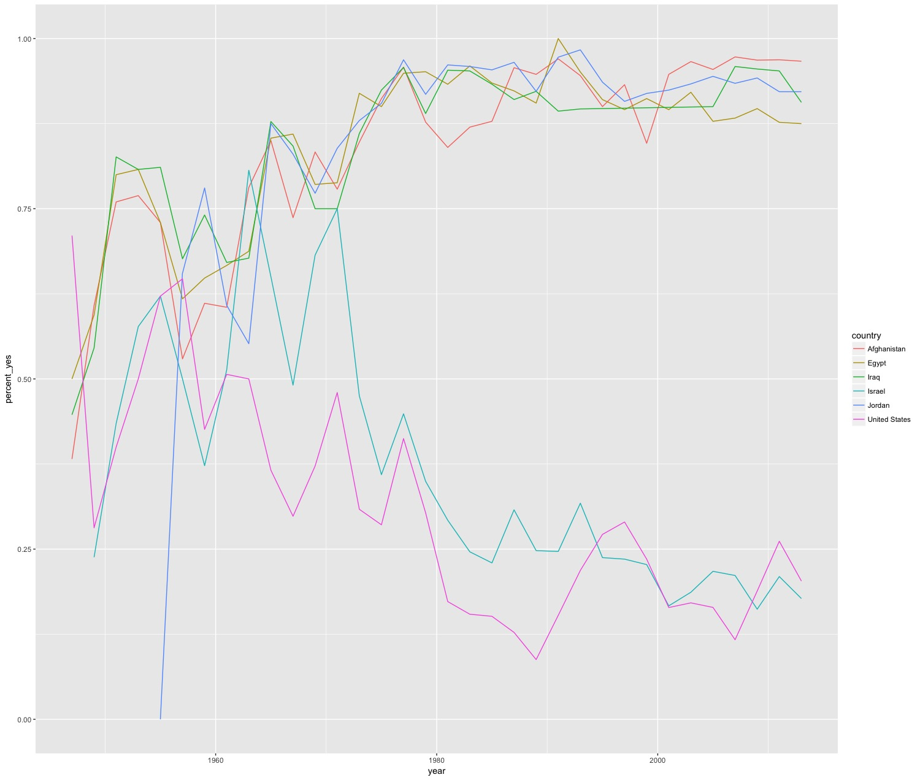
BY COUNTRY YES VOTE OVER TIME

Slide 14

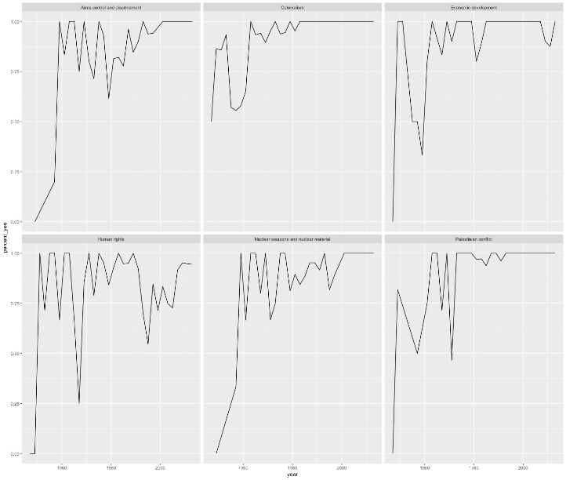
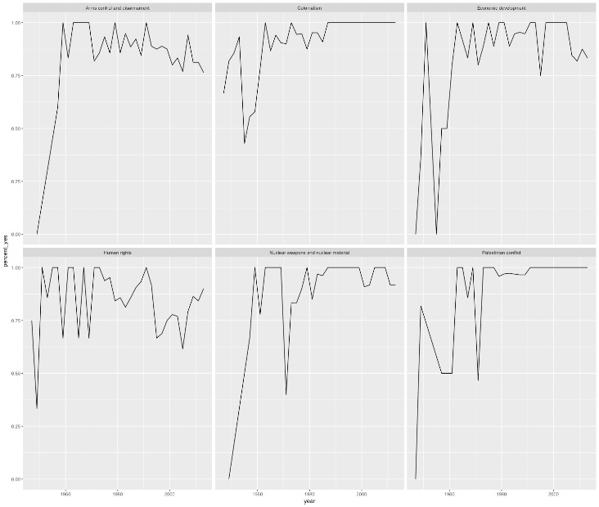
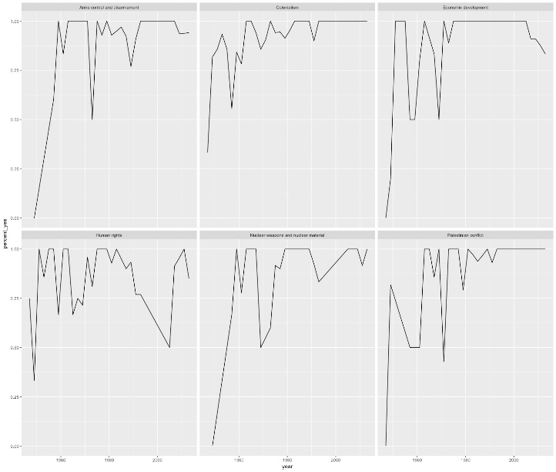
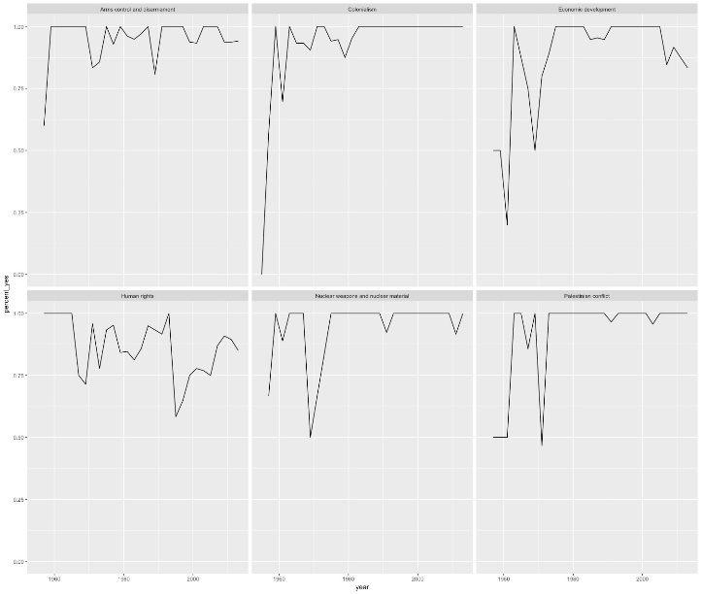
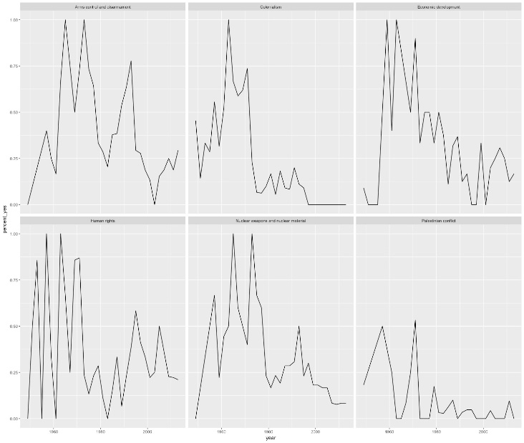
BY COUNTRY BY TOPIC OVER TIME
UNITED STATES
AFGHANISTAN
EGYPT
IRAQ
JORDAN
ISRAEL

Slide 15
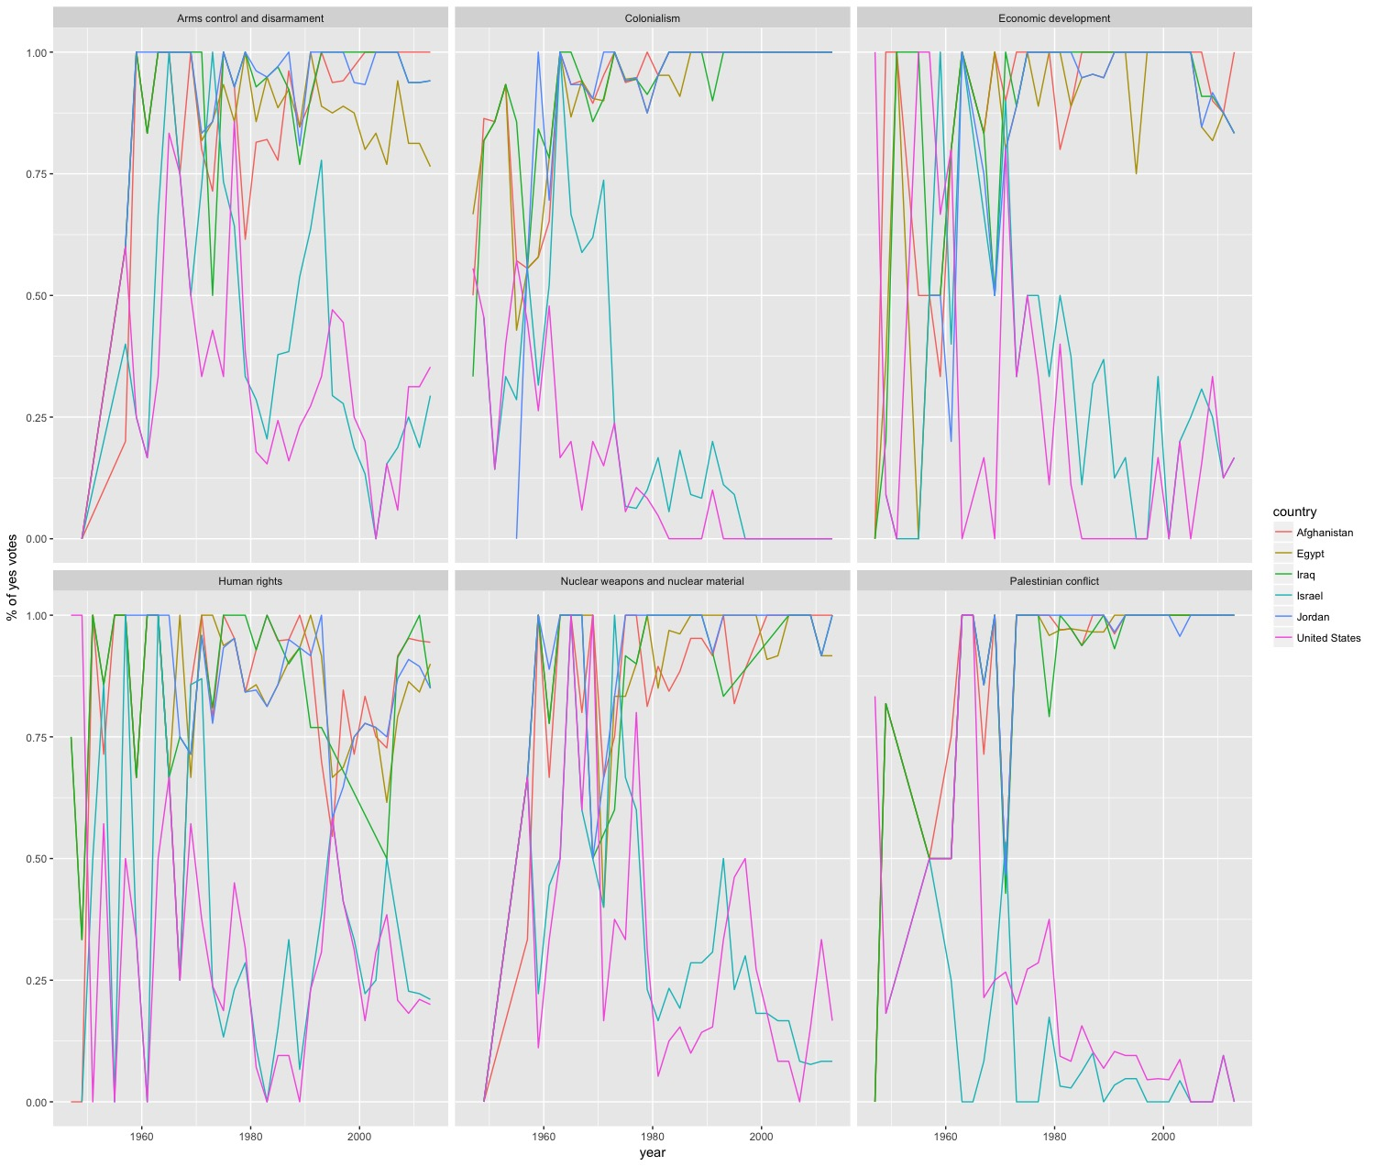
ALL COUNTRIES BY TOPIC OVER TIME

Slide 16
CONCLUSION
Of the top 5 countries receiving the most security aid from the United States annually, voting trends show that with the exception of Israel, the remaining four countries nearly always oppose the U.S. diplomatic initiatives by not aligning votes with the U.S.
Israel follows most closely to the U.S.
Exploratory data analysis allows you to take a dataset and manipulate it to uncover trends
You could further explore by comparing which country’s tended to agree or disagree with each other
Use machine learning to predict a country’s vote on a particular resolution

